Slide 1
DBMS

Slide 2
INTRODUCTION
Database is a collection of related data.
Database management system is software designed to assist the maintenance and utilization of large scale collection of data.
DBMS came into existence in 1960 by Charles Bachman. Integrated data store which is also called as the first general purpose DBMS.
Again in 1960 IBM brought IMS-Information management system.
In 1970 Edgor Codd at IBM came with new database called RDBMS.
In 1980 then came SQL Architecture- Structure Query Language.
In 1980 to 1990 there were advances in DBMS e.g. DB2, ORACLE.

Slide 3
Data
Data is raw fact or figures or entity.
When activities in the organization takes place, the effect of these activities need to be recorded which is known as Data.
Information
Processed data is called information
The purpose of data processing is to generate the information required for carrying out the business activities.

Slide 4
In general data management consists of following tasks
• Data capture: Which is the task associated with gathering the data as and when
they originate.
• Data classification: Captured data has to be classified based on the nature and
intended usage.
• Data storage: The segregated data has to be stored properly.
• Data arranging: It is very important to arrange the data properly
• Data retrieval: Data will be required frequently for further processing,
Hence it is very important to create some indexes so that data can be retrieved easily

Slide 5
Cont….
• Data maintenance: Maintenance is the task concerned with keeping the data upto-date.
• Data Verification: Before storing the data it must be verified for any error.
• Data Coding: Data will be coded for easy reference.
• Data Editing: Editing means re-arranging the data or modifying the data for presentation.
• Data transcription: This is the activity where the data is converted from one form into another.
• Data transmission: This is a function where data is forwarded to the place where it would be used further.

Slide 6
Metadata
Metadata (meta data, or sometimes meta information) is "data about data", of any sort in any media.
An item of metadata may describe a collection of data including multiple content items and hierarchical levels, for example a database schema.
Eg: A text document's metadata may contain information about how long the document is, who the author is, when the document was written, and a short summary of the document.
Metadata within web pages can also contain descriptions of page content, as well as key words linked to the content.^{[14]} These links are often called "Metatags",

Slide 7
Database:
• Database may be defined in simple terms as a collection of data
• A database is a collection of related data.
• The database can be of any size and of varying complexity.
• A database may be generated and maintained manually or it may be computerized.
Database Management System - A Database Management System (DBMS) is a collection of program that enables user to create and maintain a database.

Slide 8
Difference between File system & DBMS
File System
1. File system is a collection of data. Any management with the file system, user has to write the procedures
2. File system gives the details of the data representation and Storage of data.
3. In File system storing and retrieving of data cannot be done efficiently.
4. Concurrent access to the data in the file system has many problems like
a. Reading the file while other deleting some information, updating some information
5. File system doesn’t provide crash recovery mechanism.
6. Protecting a file under file system is very difficult.
DBMS
1. DBMS is a collection of data and user is not required to write the procedures for managing the database.
2. DBMS provides an abstract view of data that hides the details.
3. DBMS is efficient to use since there are wide varieties of sophisticated techniques to store and retrieve the data.
4. DBMS takes care of Concurrent access using some form of locking.
5. DBMS has crash recovery mechanism, DBMS protects user from the effects of system failures.
6. DBMS has a good protection mechanism.

Slide 9
Advantages of DBMS.
1. Data independency:
Application program should not be exposed to details of data representation and storage
DBMS provides the abstract view that hides these details.
2. Efficient data access.:
DBMS utilizes a variety of sophisticated techniques to store and retrieve data
efficiently.
3. Data integrity and security:
Data is accessed through DBMS, it can enforce integrity constraints.
E.g.: Inserting salary information for an employee.

Slide 10
Cont….
4. Data Administration:
When users share data, centralizing the data is an important task, Experience
professionals can minimize data redundancy and perform fine tuning which reduces
retrieval time.
5. Concurrent access and Crash recovery:
DBMS schedules concurrent access to the data. DBMS protects user from the effects of
system failure.
6. Reduced application development time.
DBMS supports important functions that are common to many applications.

Slide 11
Functions of DBMS
• Data Definition: The DBMS provides functions to define the structure of the data in the application. These include defining and modifying the record structure, the type and size of fields and the various constraints to be satisfied by the data in each field.
• Data Manipulation: Once the data structure is defined, data needs to be inserted, modified or deleted. These functions which perform these operations are part of DBMS.
• Data Security & Integrity: The DBMS contains modules which handle the
security and integrity of data in the application.

Slide 12
Cont…..
• Data Recovery and Concurrency: Recovery of the data after system failure and
concurrent access of records by multiple users is also handled by DBMS.
• Data Dictionary Maintenance: Maintaining the data dictionary which contains the
data definition of the application is also one of the functions of DBMS.
• Performance: Optimizing the performance of the queries is one of the important
functions of DBMS.

Slide 13
Role of Database Administrator.
Typically there are three types of users for a DBMS:
1. The END User who uses the application. Ultimately he is the one who actually
puts the data into the system into use in business. This user need not know
anything about the organization of data in the physical level.
2. The Application Programmer who develops the application programs. He/She has
more knowledge about the data and its structure. He/she can manipulate the data
using his/her programs. He/she also need not have access and knowledge of the
complete data in the system.
3. The Data base Administrator (DBA) who is like the super-user of the system.

Slide 14
The role of DBA is very important and is defined by the following functions.
• Defining the schema: The DBA defines the schema which contains the structure of the data in the application. The DBA determines what data needs to be present in the system and how this data has to be presented and organized.
• Liaising with users: The DBA needs to interact continuously with the users to understand the data in the system and its use.
• Defining Security & Integrity checks: The DBA finds about the access restrictions to be defined and defines security checks accordingly. Data Integrity checks are defined by the DBA.
• Defining Backup/Recovery Procedures: The DBA also defines procedures for backup and recovery. Defining backup procedure includes specifying what data is to be backed up, the periodicity of taking backups and also the medium and storage place to backup data.
• Monitoring performance: The DBA has to continuously monitor the performance of the queries and take the measures to optimize all the queries in the application.

Slide 15
Simplified Database System Environment:
A database management system (DBMS) is a collection of programs that enables users to create and maintain database.
The DBMS is a general purpose software system that facilitates the process of defining, constructing, manipulating and sharing databases among various users and applications.
Defining a database specifying the database involves specifying the data types, constraints and structures of the data to be stored in the database.
The descriptive information is also stored in the database in the form database catalog or dictionary; it is called meta-data.
Manipulating the data includes the querrying the database to retrieve the specific data. An application program accesses the database by sending the qurries or requests for data to DBMS.
The important function provided by the DBMS includes protecting the database and maintain the database.

Slide 16
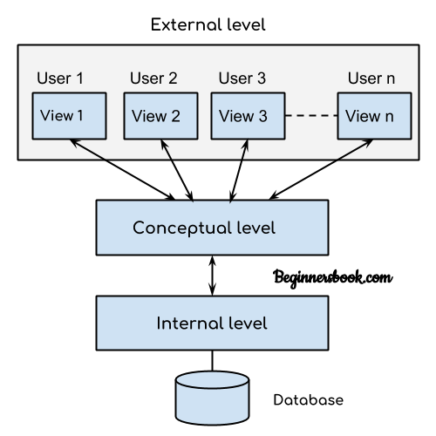

Slide 17
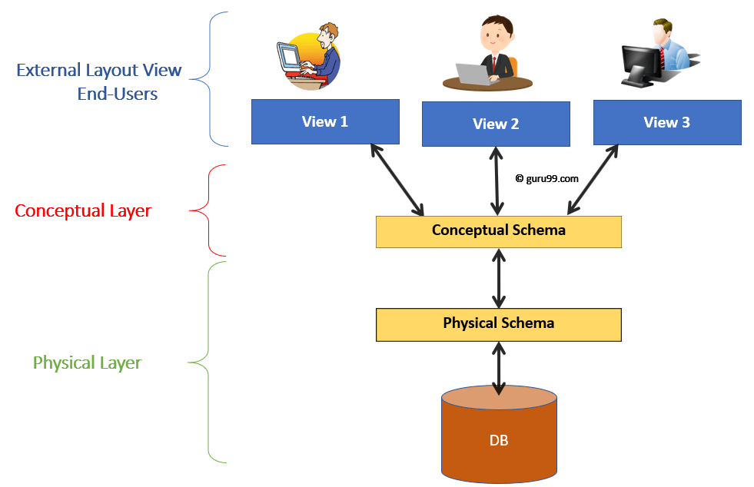

Slide 18
Architecture of DBMS
A commonly used views of data approach is the three-level architecture suggested by ANSI/SPARC (American National Standards Institute/Standards Planning and Requirements Committee).
The three levels of the architecture are three different views of the data:
External - individual user view
Conceptual - community user view
Internal - physical or storage view

Slide 19
external level
The external level is the view that the individual user of the database has. This view is often a restricted view of the database and the same database may provide a number of different views for different classes of users.
For example, a department head may only be interested in the departmental finances and student enrolments but not the library information. The librarian would not be expected to have any interest in the information about academic staff.
s/w and h/w independent

Slide 20
The conceptual view
The conceptual view is the information model of the enterprise and contains the view of the whole enterprise without any concern for the physical implementation. This view is normally more stable than the other two views.
In a database, it may be desirable to change the internal view to improve performance while there has been no change in the conceptual view of the database.
The conceptual view is defined by the conceptual schema which includes definitions of each of the various types of data.
Overall view keeping in consideration od DBMS software to be used, hence this view is dependent on s/w but not on h/w

Slide 21
The internal view
The internal view is the view about the actual physical storage of data. It tells us what data is stored in the database and how.
At least the following aspects are considered at this level:
Storage allocation e.g. B-trees, hashing etc.
Access paths e.g. specification of primary and secondary keys, indexes and pointers and sequencing.
Miscellaneous e.g. data compression and encryption techniques, optimization of the internal structures.
At least the following aspects are considered at this level: Storage allocation e.g. B-trees, hashing etc. Access paths e.g. specification of primary and secondary keys, indexes and pointers and sequencing. Miscellaneous e.g. data compression and encryption techniques, optimization of the internal structures.
Both s/w and h/w dependent.

Slide 22
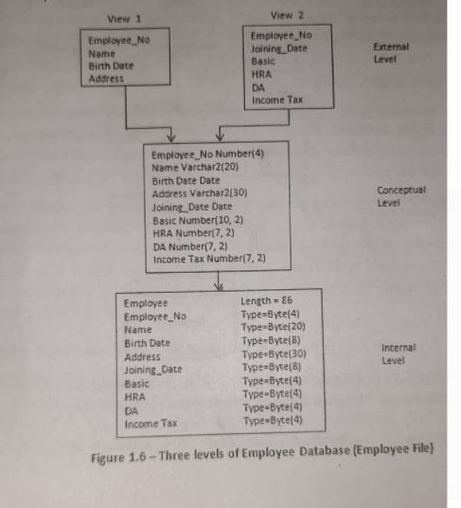

Slide 23
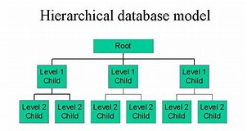
Data models
Hierarchical Model:
A hierarchical data model is a data model which the data is organized into a tree like structure.
The structure allows repeating information using parent/child relationships: each parent can have many children but each child only has one parent.
All attributes of a specific record are listed under an entity type.

Slide 24
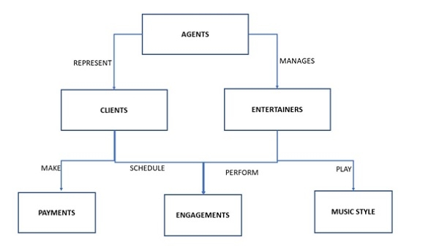
Network model

Slide 25
Data Independence
Data independence can be defined as the capacity to change the schema at one level without changing the schema at next higher level. There are two types of data Independence.
They are
1. Logical data independence.
2. Physical data independence.
1. Logical data independence is the capacity to change the conceptual schema without having to change the external schema.
2. Physical data independence is the capacity to change the internal schema without changing the conceptual schema.

Slide 26
Types of Databases and Database Applications • Traditional Applications:
Numeric and Textual Databases
• More Recent Applications:
Multimedia Databases
Geographic Information Systems (GIS)
Data Warehouses Real-time
and Active Databases Many other application

